Slide 1

Basic Statistics for Data Science-2
Aksadur Rahman
aksadur@yahoo.com

Slide 2
Agenda
Normal Distribution
Deciles, Percentiles and Quartiles
Inter-quartile Range
Five Number Summary
Box Plot
Coefficient of Correlation
Standard Score (Z-score, T-score)
Population Data Vs Sample Data

Slide 3
Normal Distribution
Gaussian Distribution
(পরিমিত বিন্যাস)

Slide 4
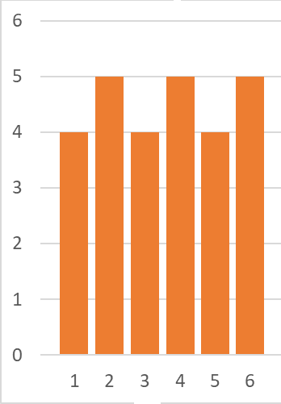
Uniform Distribution
[1,1,1,1, 2,2,2,2,2, 3,3,3,3, 4,4,4,4,4, 5,5,5,5, 6,6,6,6,6]

Slide 5
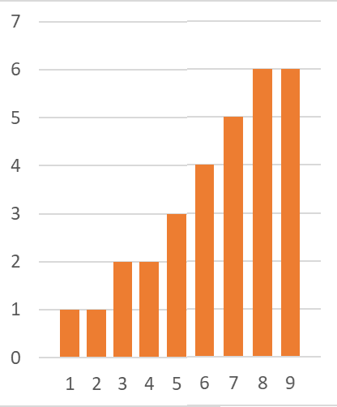
Left Skewed Distribution
[1, 2, 3,3, 4,4, 5,5,5, 6,6,6,6, 7,7,7,7,7, 8,8,8,8,8,8, 9,9,9,9,9,9]

Slide 6
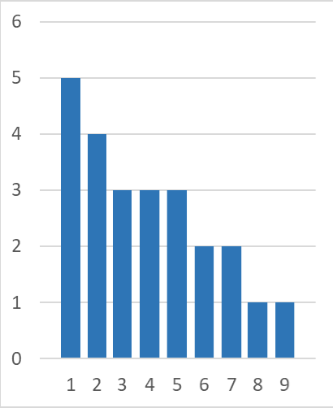
Right Skewed Distribution
[1,1,1,1,1, 2,2,2,2, 3,3,3, 4,4,4, 5,5,5, 6,6, 7,7, 8, 9]

Slide 7
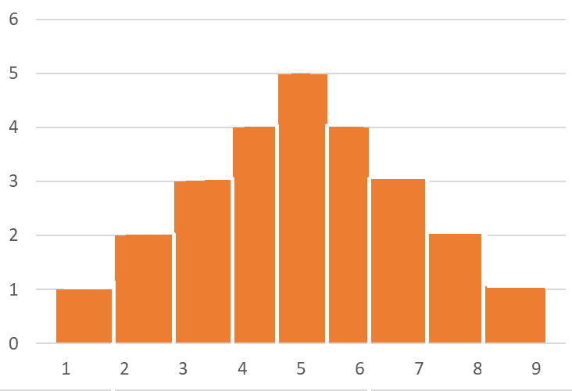
Normal Distribution/Gaussian distribution
[1, 2,2, 3,3,3, 4,4,4,4, 5,5,5,5,5, 6,6,6,6, 7,7,7, 8,8, 9]

Slide 8
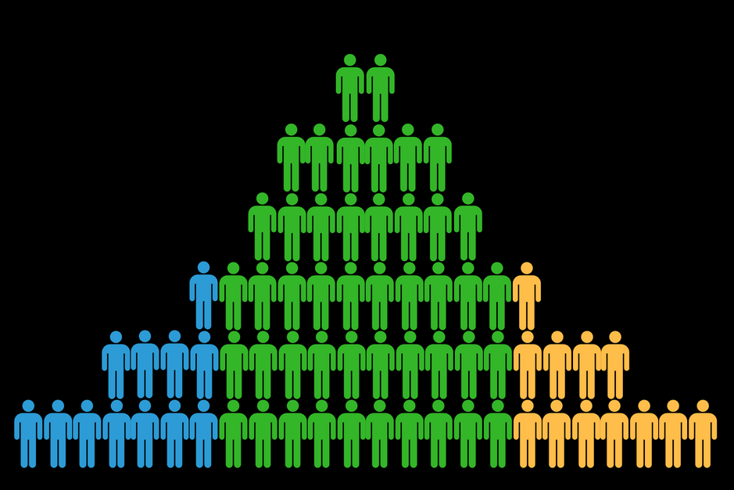
Normal Distribution/Gaussian distribution

Slide 9
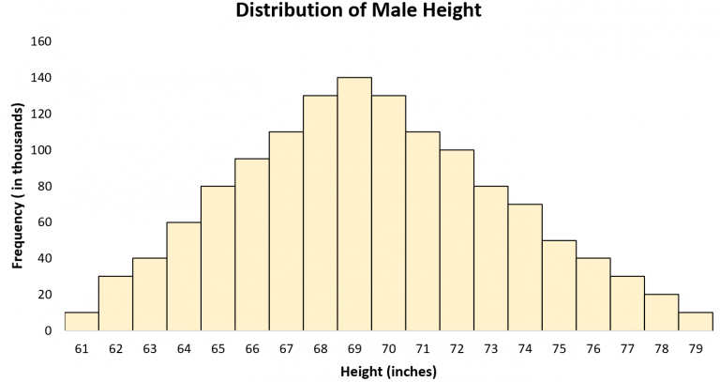
Normal Distribution

Slide 10
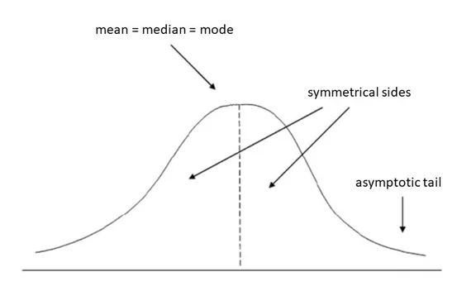
Normal Distribution
Bell Curve
Mean = Median = Mode
Symmetrical
Kurtosis = 0.263
Asymptotic
Mean as a starting point
SD as a unit of Measurement
-3SD to +3SD
10000 Cases
3413, 1359, 215

Slide 11
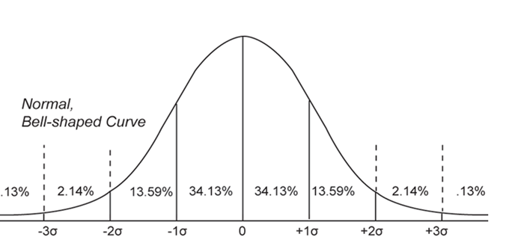
Normal Distribution/Gaussian distribution
Bell Curve
Mean = Median = Mode
Symmetrical
Kurtosis = 0.263
Asymptotic
Mean as a starting point
SD as a unit of Measurement
-3SD to +3SD
10000 Cases
3413, 1359, 215

Slide 12
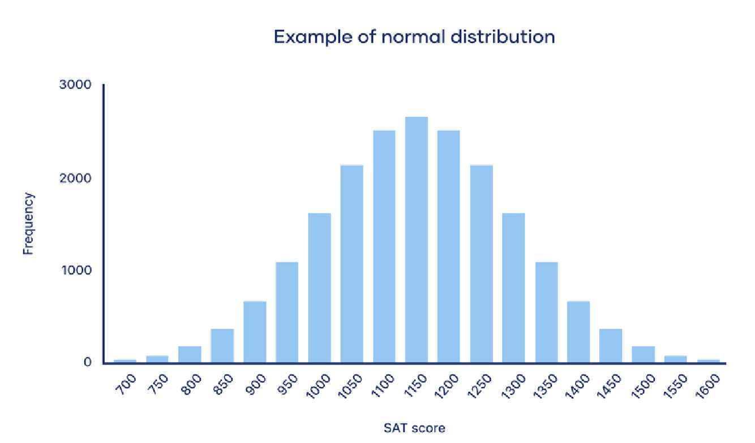
Normal Distribution/Gaussian distribution
Bell Curve
Mean = Median = Mode
Symmetrical
Kurtosis = 0.263
Asymptotic
Mean as a starting point
SD as a unit of Measurement
-3SD to +3SD
10000 Cases
3413, 1359, 215

Slide 13
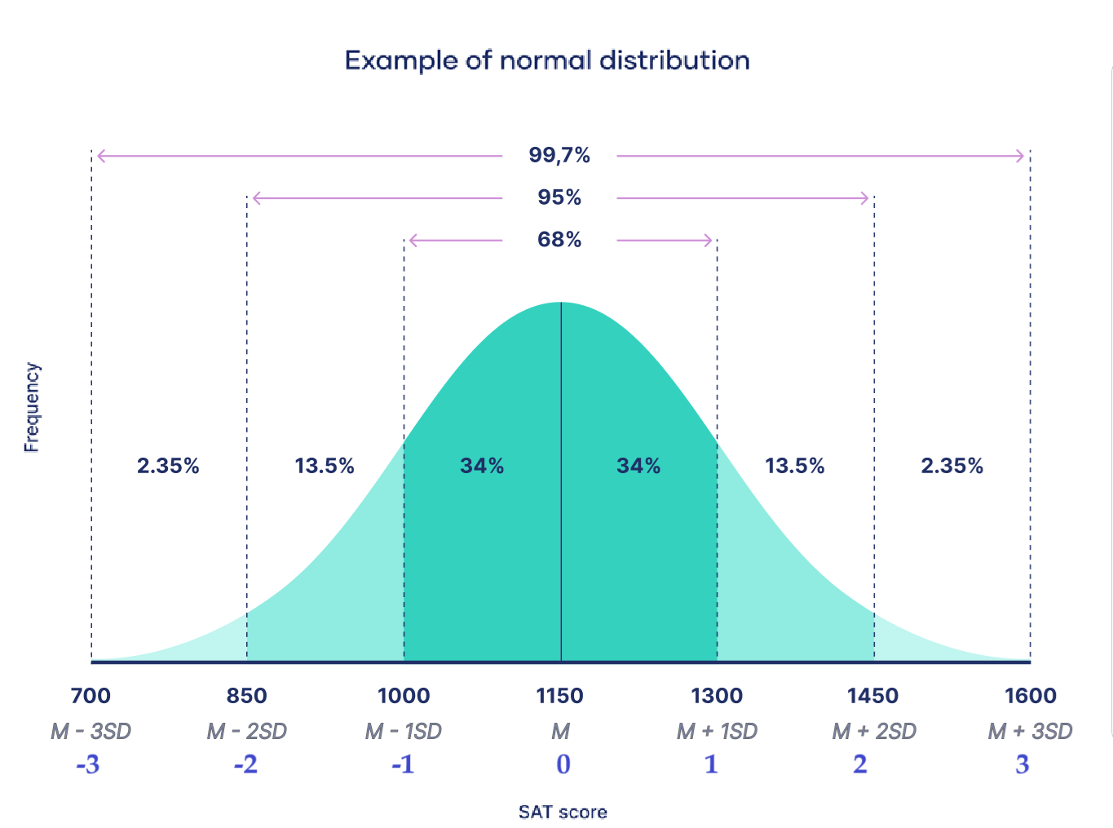
Normal Distribution/Gaussian distribution
Bell Curve
Mean = Median = Mode
Symmetrical
Kurtosis = 0.263
Asymptotic
Mean as a starting point
SD as a unit of Measurement
-3SD to +3SD
10000 Cases
3413, 1359, 215

Slide 14
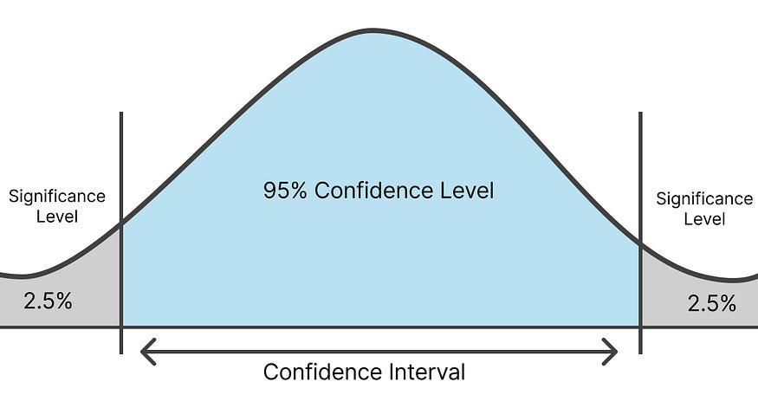
Confidence Level/Significant Level

Slide 15
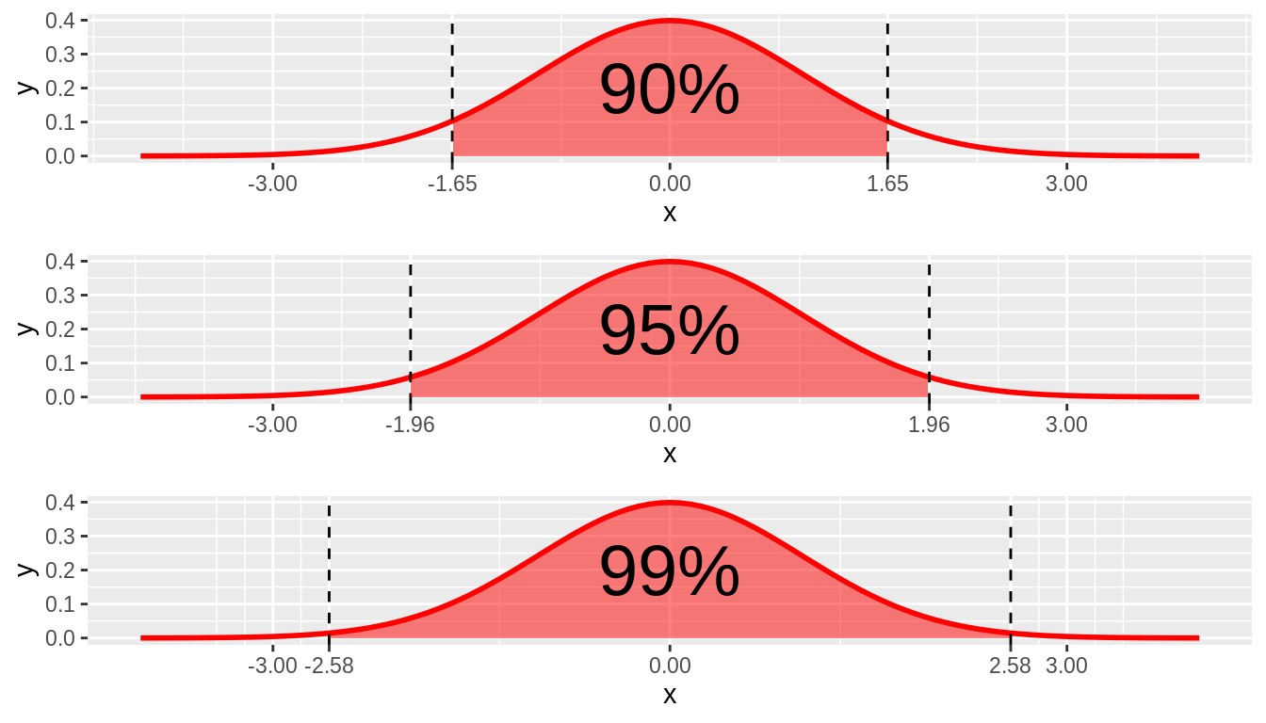
Confidence Level/Significant Level

Slide 16
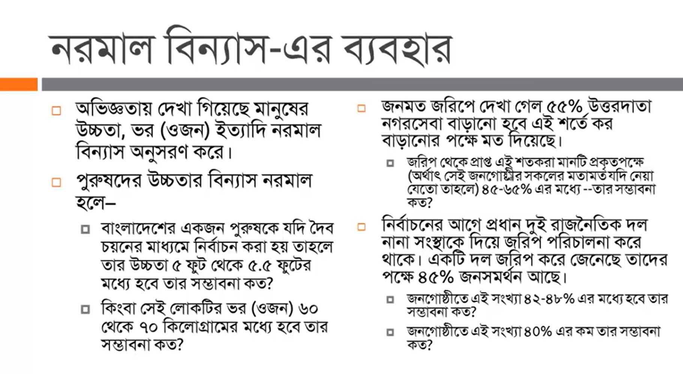
Normal Distribution/Gaussian distribution

Slide 17
Measures of Location
Deciles: If data is ordered and divided into 10 parts, then cut points are called Deciles
Percentiles: If data is ordered and divided into 100 parts, then cut points are called Percentiles. 25th percentile is the Q1, 50th percentile is the Median (Q2) and the 75th percentile of the data is Q3.
In notations, percentiles of a data is the ((n+1)/100)p th observation of the data, where p is the desired percentile and n is the number of observations of data.

Slide 18
Methods of Variability Measurement
Quartiles: If data is ordered and divided into 4 parts, then cut points are called Quartile
The first quartile (Q1) is the first 25% of the data. The second quartile (Q2) is between the 25th and 50th percentage points in the data. The upper bound of Q2 is the median. The third quartile (Q3) is the 25% of the data lying between the median and the 75% cut point in the data.
Q1 is the median of the first half of the ordered observations and Q3 is the median of the second half of the ordered observations.
Inter-quartile Range: Difference between Q3 and Q1. Inter-quartile range of the previous example is 61- 40=21. The middle half of the ordered data lie between 40 and 61.

Slide 19
Five Number Summary
Five Number Summary: The five number summary of a distribution consists of the smallest (Minimum) observation, the first quartile (Q1),
The median(Q2), the third quartile(Q3), and the largest (Maximum) observation written in order from smallest to largest.
Box Plot: A box plot is a graph of the five number summary. The central box spans the quartiles. A line within the box marks the median. Lines extending above and below the box mark the smallest and the largest observations (i.e., the range). Outlying samples may be additionally plotted outside the range.

Slide 20
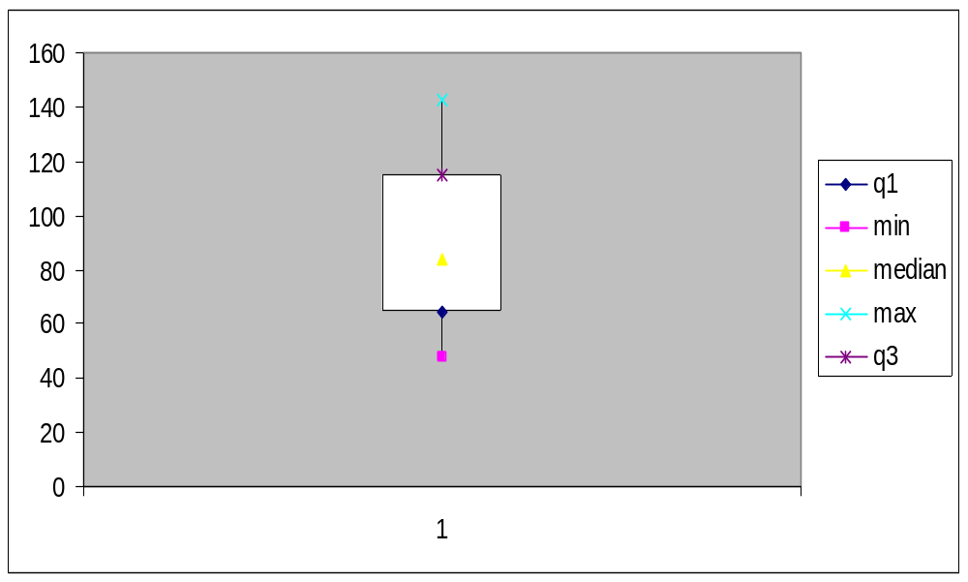
Boxplot

Slide 21
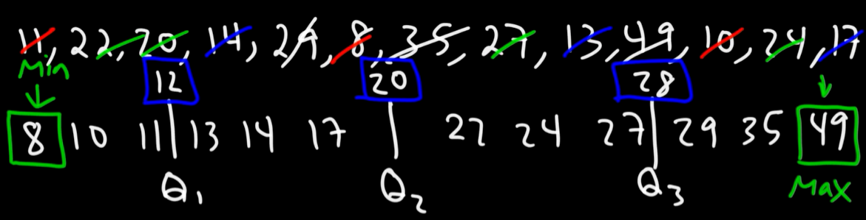
Boxplot
outlier
[Q1 - 1.5*IQR, Q3 + 1.5*IQR]
= [12 - 1.5*16, 28 + 1.5*16]
= [12-24, 28+24] = [-12, 52]
Above or under this range is outlier
IQR = Q3-Q1 = 28-12=16

Slide 22
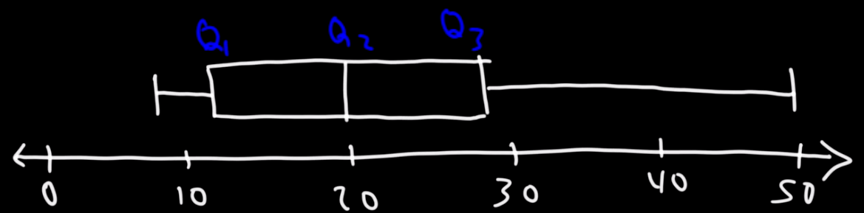
Boxplot

Slide 23
18, 34, 76, 29, 15, 41, 46, 25, 54, 38, 20, 32, 43, 22
22
33
43
15
18
20
25
29
32
34
38
41
46
54
76
Q1
Q2
Q3
Outlier
=[Q1 - 1.5 * IQR , Q3 + 1.5 * IQR]
= [22 - 1.5 * 21 , 43 + 1.5 * 21] [IQR= Q3-Q1= 43-22= 21]
= [22 -31.5 , 43 + 31.5]
= [-9.5 , 74.5]

Slide 24
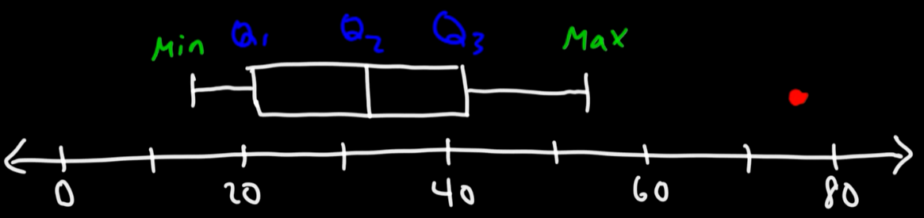
Boxplot

Slide 25
Coefficient of Correlation

Slide 26
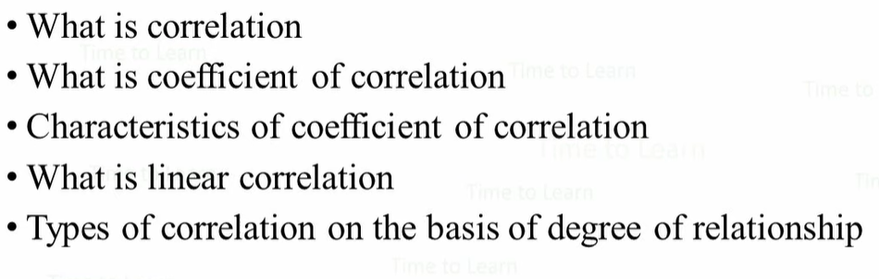
Coefficient of Correlation

Slide 27
Correlation
Correlation is a statistical measure that indicates the extent to which two or more variables fluctuate in relation to each other
Coefficient of Correlation
A correlation coefficient is a number between -1 and 1 that tells you the strength and direction of a relationship between variables. In other words, it reflects how similar the measurements of two or more variables are across a dataset.

Slide 28
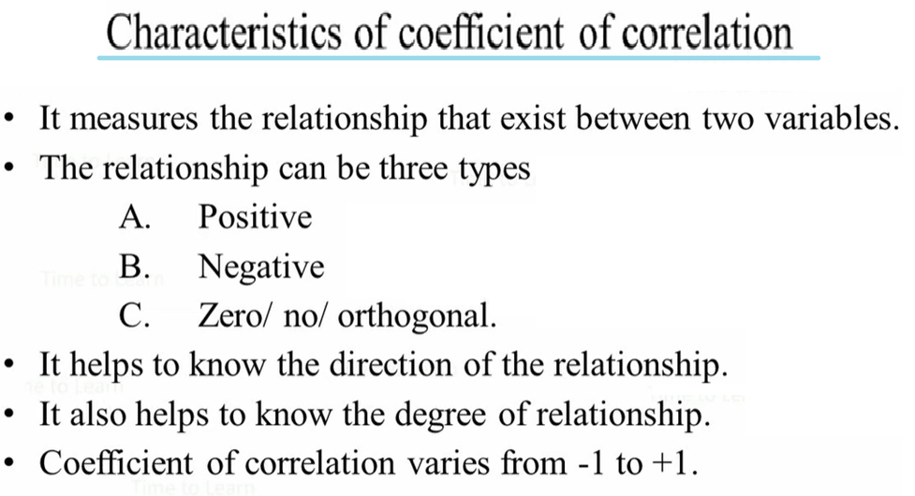

Slide 29
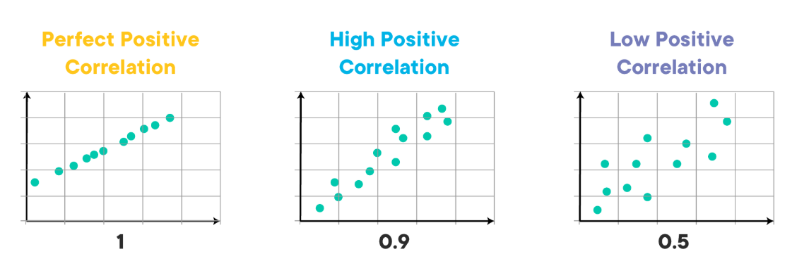
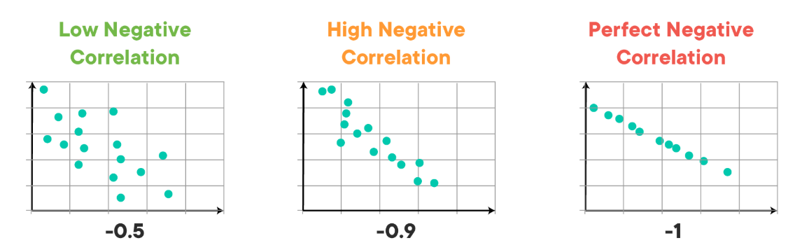
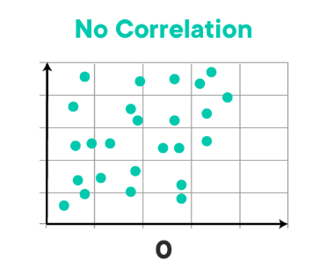

Slide 30
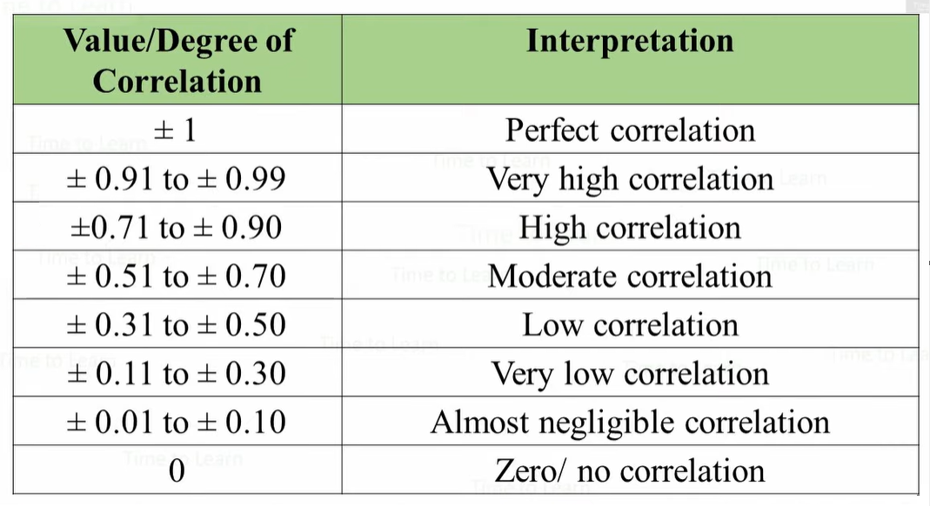

Slide 31
How to calculate Correlation
Age x | Glucose Level y
43 | 99
21 | 65
25 | 79
42 | 75
57 | 87
59 | 81

Slide 32
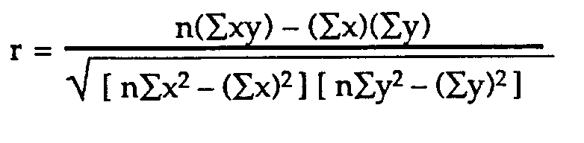
How to calculate Correlation
Subject | Age x | Glucose Level y | xy | x² | y²
1 | 43 | 99 | 4257 | 1849 | 9801
2 | 21 | 65 | 1365 | 441 | 4225
3 | 25 | 79 | 1975 | 625 | 6241
4 | 42 | 75 | 3150 | 1764 | 5625
5 | 57 | 87 | 4959 | 3249 | 7569
6 | 59 | 81 | 4779 | 3481 | 6561
Σ | 247 | 486 | 20485 | 11409 | 40022

Slide 33
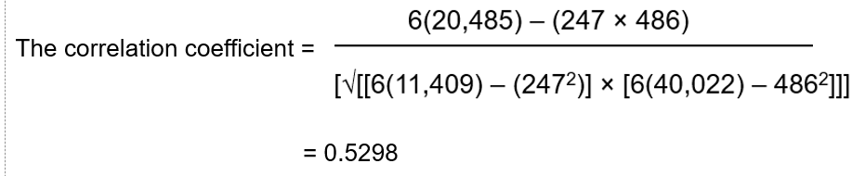
How to calculate Correlation
From our table:
      Σx = 247
      Σy = 486
      Σxy = 20,485
      Σx² = 11,409
      Σy² = 40,022
      n is the sample size, in our case = 6

Slide 34
Standard Score
(Z Score, T Score)

Slide 35
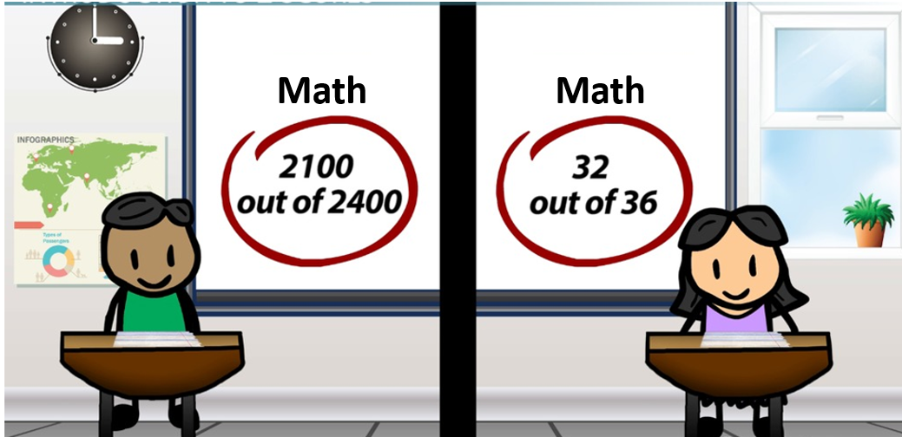
Standard Score

Slide 36
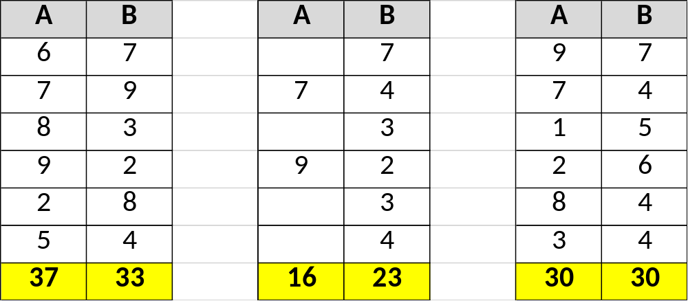
Standard Score
Total
Mean
SD
Standard Score
 | ABC Math | XYZ Math
M | 70 | 30
SD | 20 | 10
X | 80 | 50

Slide 37
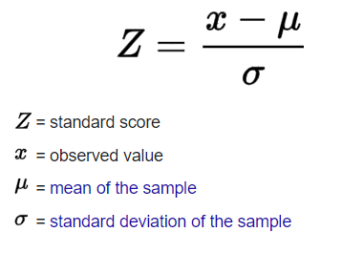

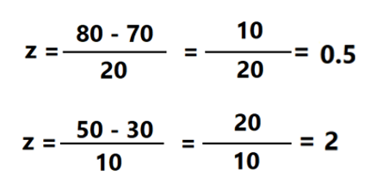
Standard Score
Z-Score
T-Score
 | ABC Math | XYZ Math
M | 70 | 30
SD | 20 | 10
X | 80 | 50
Z-Score | 0.5 | 2

Slide 38

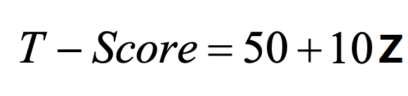
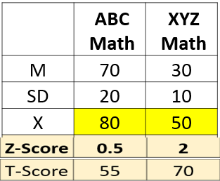


Standard Score
T-Score

Slide 39
Population Data
Vs
Sample Data

Slide 40
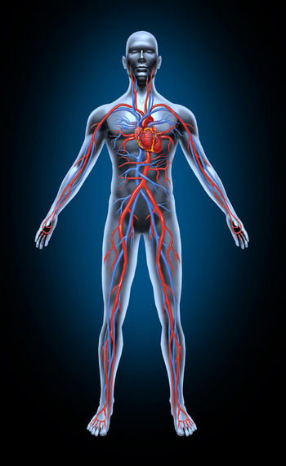
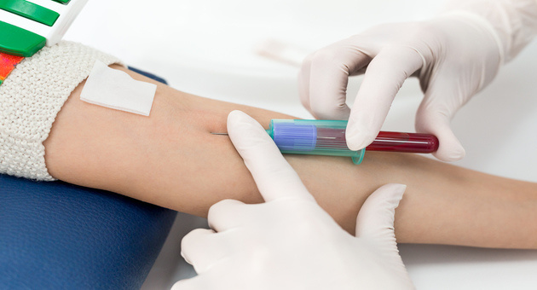


Population Vs Sample
Population Data
Sample Data

Slide 41
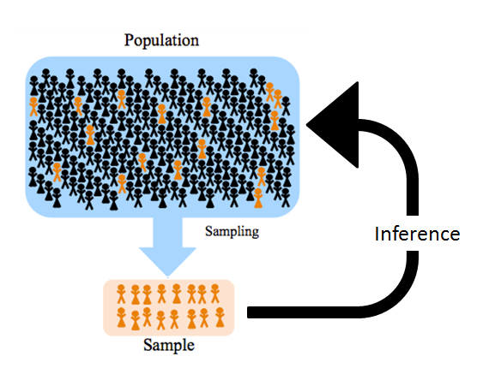
Population Vs Sample

Slide 42
Population Vs Sample
Population Data
A population includes all members from a specified group, all possible outcomes or measurements
Sample Data
A sample consists of some observations drawn from the population, so a part or a subset of the population.
Sample is the representative of the Population
Sample should be large enough to represent the Population

Slide 43
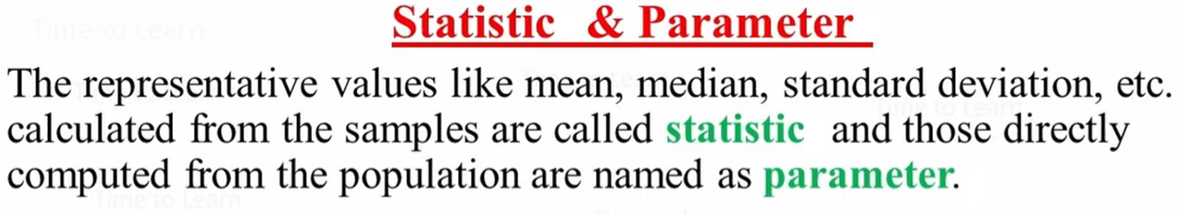
Population Vs Sample

Slide 44
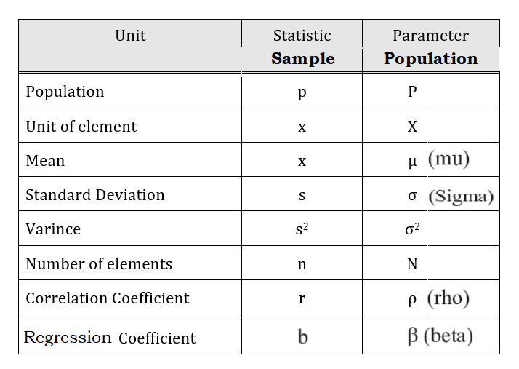
Population Vs Sample
Parameters are usually Greek letters or capital letters. Statistics are typically Roman letters or small letters.

Slide 45
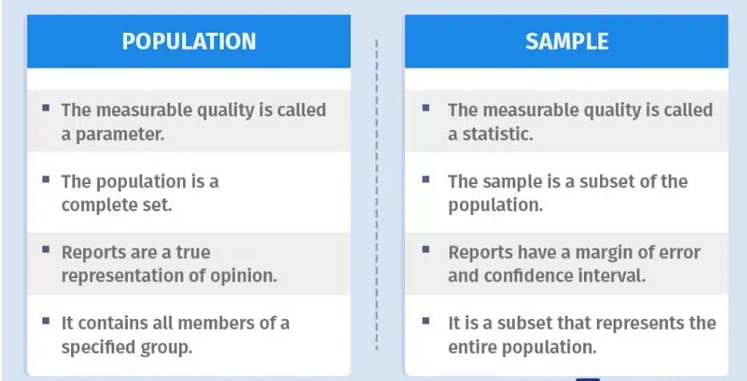
Population Vs Sample

Slide 46
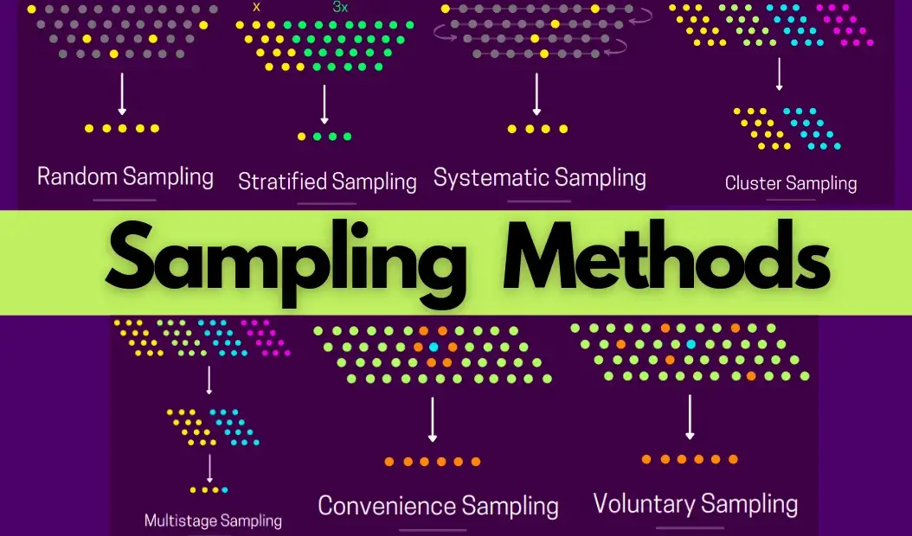
Population Vs Sample

Slide 47
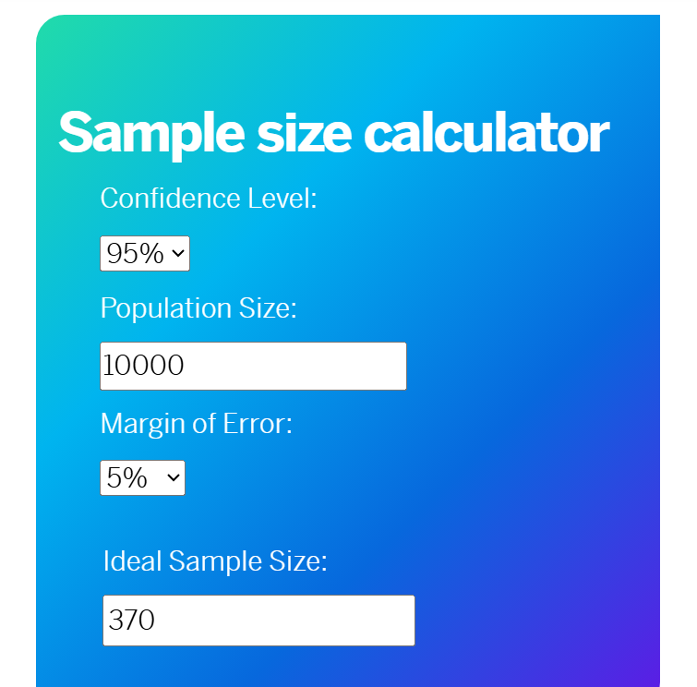
Population Vs Sample
https://www.qualtrics.com/blog/calculating-sample-size/

